Slide 1

GitHub Copilot for Portfolio Management
A simple, interactive portfolio management system powered by GitHub Copilot, demonstrating AI agent formation through structured prompts.
Presenters: ARYAN BARNWAL, GAUTAM VEER, ABHIRAM VELADINENI
Team: Auralis
Domain: GenAI

Slide 2

Project Goals: AI Agents in Action
Demonstrate AI Agents
Showcase how AI agents can be formed using structured prompts.
Manage Synthetic Portfolio
Manage a four-asset portfolio without external data dependencies.
Simulate Performance
Simulate portfolio performance using lightweight Python scripts.
Text-Based Interface
Provide a clear, text-based interface for user interaction.

Slide 3
System Overview: Core Components
01
02
03
Price & Return Generator
Orchestrator Script
Copilot-Powered Agents
Dummy generator for four assets (ST A, ST B, ST C, ST D) and a return calculator.
Prepares input files for Copilot agents.
Three distinct agents: Momentum, Risk Parity, and Allocation.
04
05
Python Output Files
Simulation Engine & Dashboard
Contains MOMENTUM_WEIGHTS, RISK_WEIGHTS, and FINAL_WEIGHTS.
Pure-Python engine and a simple terminal dashboard for visualization.

Slide 4
Key Principles: Lean & Transparent
Minimal Dependencies
Transparency
No external models or financial APIs are used, ensuring a lightweight system.
Every step of the process is visible and editable, promoting understanding.
Agent Modularity
Human-in-the-Loop
Each agent operates with its own prompt and rules, allowing for independent development.
Copilot is triggered manually with a single keystroke, maintaining user control.

Slide 5
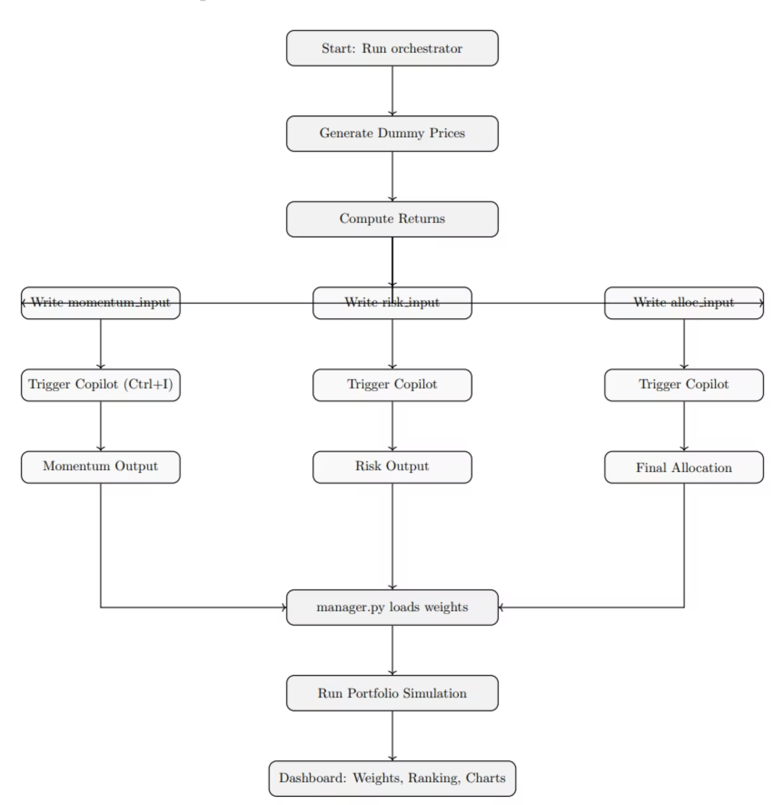
Workflow of Copilot-Driven Portfolio Management

Slide 6




Workflow: Copilot-Driven Portfolio Management
The workflow begins with price and return generation, followed by preparing agent inputs. Copilot then acts as an agent, generating outputs that feed into the simulation and UI.
Price & Return Generation
Random price movements converted to daily returns.
Prepare Agent Inputs
Text files with returns, rules, and instructions for each agent.
Copilot as Agent
Manual trigger (Ctrl + Shift + I) to generate Python dictionaries.
Simulation & UI
Final weights calculate equity curve and render dashboard.

Slide 7
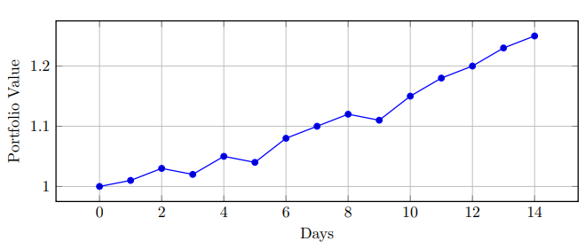
Sample Output: Equity Curve
This equity curve demonstrates the simulated performance of the portfolio using synthetic data. It visually represents the growth or decline of the portfolio over time, based on the agents' allocation decisions.
The curve provides a clear, intuitive understanding of the system's effectiveness in a controlled environment.

Slide 8
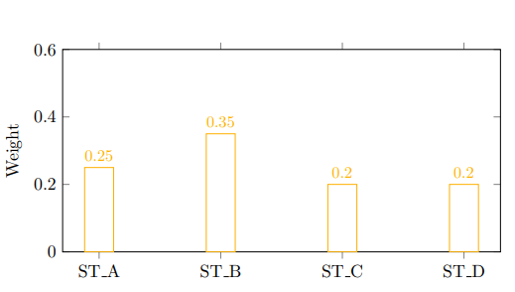
Sample Output: Weight Distribution
This chart illustrates the final weight distribution across the four synthetic assets (ST A, ST B, ST C, and ST D) as determined by the Allocation Agent.
It shows how the combined logic of momentum and risk parity agents translates into concrete investment proportions for each asset.

Slide 9
Limitations: Understanding the Scope
Manual Operation: Copilot requires manual triggering, limiting full automation.
Synthetic Data: The system relies solely on synthetic data, not real-world market information.
Ignored Factors: Transaction costs and other real-world constraints are not considered.
Prompt Sensitivity: Output quality is dependent on the phrasing of the prompts given to Copilot.
Single-Period Allocation: The model generates one-period allocations, without rolling rebalancing.

Slide 10

Thank You
We are happy to take any questions.

